Slide 1

HTTP Protocol
HTML Forms, HTTP Request & HTTP Response
SoftUni Team
Technical Trainers
Software University
http://softuni.bg

Slide 2
Table of Contents
HTTP Basics – Web Communication explained
HTML Forms – Method & Action
URL
MIME & Media Types
HTTP Request
HTTP Response

Slide 3
Have a Question?
sli.do #csharp-web

Slide 4
http://
HTTP Basics
Web Communication Explained

Slide 5



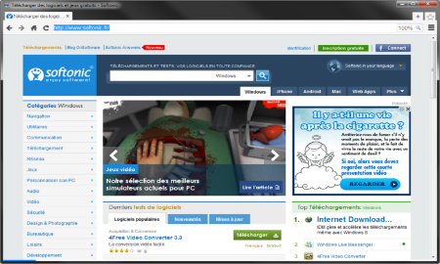





Web Server Work Model
Web Client
Web Server
Technology
Request
Response
Web Resources
Database
HTML, PDF, JPG…

Slide 6

Web Server Work Model
Web Client
Web Server
Technology
Request
.NET Core
Response
Web Resources
Database
HTML, PDF, JPG…

Slide 7


Hyper Text Transfer Protocol
Request
Response
HTTP
HTTP
TCP
TCP
IP
IP
Ethernet
Media (wires / air / fiber)
Ethernet
Notes:
HTTP == Hyper Text Transfer Protocol
Client-server protocol for transferring Web resources (HTML files, images, styles, scripts, data, etc.)
The widespread protocol for Internet communication today
Request-response model (client requests, server answers)
Text-based format (human readable)
Relies on unique resource URLs
Provides resource metadata (e.g. encoding)
Stateless (cookies and Web storages can overcome this)

Slide 8
HTTP Request Methods
Method | Description
POST | Create / store a resource
GET | Read / retrieve a resource
PUT | Update / modify a resource
DELETE | Delete / remove a resource
Other HTTP Methods
CONNECT
HEAD
OPTIONS
TRACE
The four basic functions of persistence storage.
to indicate the desired action to be performed on the

Slide 9
HTTP Conversation: Example
GET /courses/javascript HTTP/1.1
Host: www.softuni.bg
User-Agent: Mozilla/5.0
<CRLF>
HTTP request:
HTTP response:
The empty line denotes the end of the request headers
HTTP/1.1 200 OK
Date: Mon, 5 Jul 2010 13:09:03 GMT
Server: Microsoft-HTTPAPI/2.0
Last-Modified: Mon, 12 Jul 2014 15:33:23 GMT
Content-Length: 54
<CRLF>
<html><title>Hello</title>
Welcome to our site</html>
The empty line denotes the end of the response headers

Slide 10

Dev Tools
Tools for Developers

Slide 11
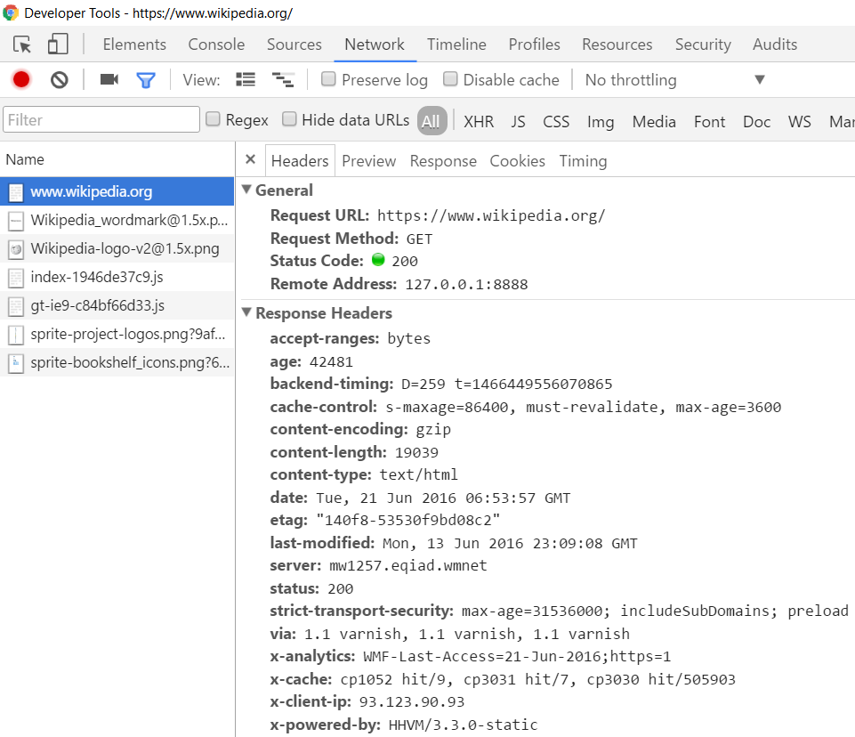
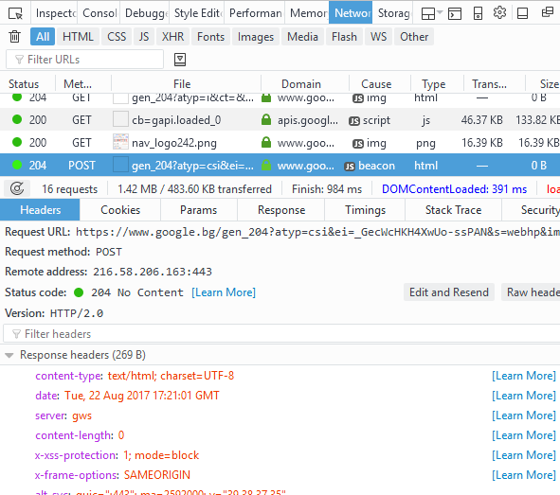
Tools for Developers – Browser Dev Tools
Chrome Developer Tools
Mozilla Developer Tools

Slide 12

Tools for Developers – Browser Add-ons
</>
Postman - Chrome
Rested - Firefox

Slide 13

HTTP Tools for Developers - Desktop
Fiddler
Postman

Slide 14

HTML Forms
Form Method and Action

Slide 15
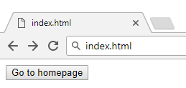

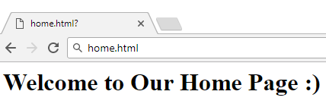

HTML Forms - Action Attribute
Relative URL to the current file
<form action="home.html">
<input type="submit" value="Go to homepage"/>
</form>
Defines where to submit the form data:

Slide 16
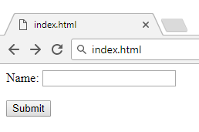

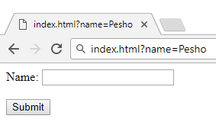

HTML Forms – Method Attribute
Specifies the HTTP method to use when sending form data
<form method="get"> Name: <input type="text" name="name"> <br /><br />
<input type="submit" value="Submit">
</form>
The form data is in the URL

Slide 17
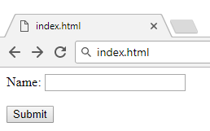

HTML Forms – Method Attribute (2)
<form method="post"> Name: <input type="text" name="name"> <br /><br />
<input type="submit" value="Submit">
</form>
Headers will be explained later
POST http://localhost/index.html HTTP/1.1
Host: localhost
Content-Type: application/x-www-form-urlencoded
Content-Length: 10
name=Pesho
HTTP request body holds the request form data and the response data

Slide 18
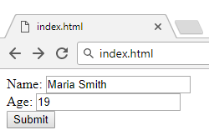
URL Encoded Form Data – Example
<form method="post">
Name: <input type="text" name="name"/> <br/>
Age: <input type="text" name="age"/> <br/>
<input type="submit" />
</form>
POST http://localhost/cgi-bin/index.cgi HTTP/1.1
Host: localhost
Content-Type: application/x-www-form-urlencoded
Content-Length: 23
name=Maria+Smith&age=19
File uploads are not supported

Slide 19

URL
Uniform Resource Locator

Slide 20
Uniform Resource Locator (URL)
http://mysite.com:8080/demo/index.php?id=27&lang=en#lectures
Protocol
Host
Port
Path
Query String
Fragment
URL is a formatted string, consisting of:
Protocol for communicating (http, ftp, https...) – HTTP in most cases
Host or IP address (www.softuni.bg, gmail.com, 127.0.0.1, web)
Port (the default port is 80) – a number in range [0…65535]
Path (/forum, /path/index.php)
Query string (?id=27&lang=en)
Fragment (#lectures) – used on the client to navigate to some section

Slide 21
Query String in C#
Query string contains data that is not part of the path structure
Commonly used in searches and dynamic pages
It is the part of a URL following a question mark (?)
Multiple parameters are separated by some delimiter
http://example.com/path/to/page?name=ferret&color=purple

Slide 22
URL Encoding
URLs are encoded according RFC 1738:
Unreserved URL characters – have no special meaning
Reserved URL characters – can have a special meaning in the URL
Reserved characters are escaped by percent encoding
Space is encoded as "+" or "%20"
[0-9a-zA-Z]
! * ' ( ) ; : @ & = + $ / , ? # [ ]
%[character hex code]

Slide 23
URL Encoding - Examples
All other characters are escaped by %
Char | URL Encoding
space | %20
щ | %D1%89
" | %22
# | %23
$ | %24
% | %25
& | %26
Each character is converted to its ASCII value, represented as hexadecimal digits
Наков-爱-SoftUni
%D0%9D%D0%B0%D0%BA%D0%BE%D0%B2-%E7%88%B1-SoftUni

Slide 24
Valid and Invalid URLs – Examples
Some valid URLs:
Some invalid URLs:
http://www.google.bg/search?sourceid=navclient&ie=UTF-8&rlz=1T4GGLL_enBG369BG369&q=http+get+vs+post
http://bg.wikipedia.org/wiki/%D0%A1%D0%BE%D1%84%D1%82%D1%83%D0%B5%D1%80%D0%BD%D0%B0_%D0%B0%D0%BA%D0%B0%D0%B4%D0%B5%D0%BC%D0%B8%D1%8F
Should be: C%23+.NET+4.0
http://www.google.bg/search?&q=C# .NET 4.0
Should be: %D0%B1 %D0%B8%D1%80%D0%B0
http://www.google.bg/search?&q=бира

Slide 25

MIME and Media Types
Multi-Purpose Internet Mail Extensions

Slide 26
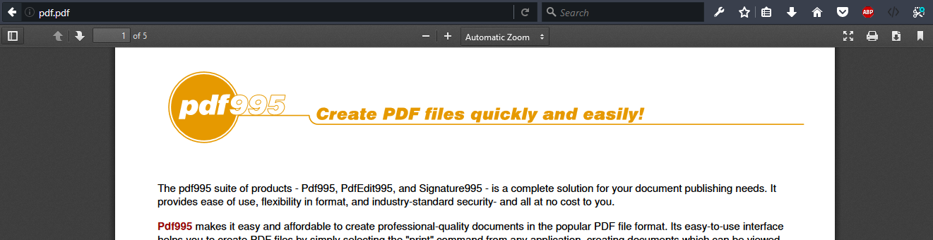
What is MIME?
MIME == Multi-Purpose Internet Mail Extensions
Internet standard for encoding resources
Originally developed for email attachments
Used in many Internet protocols like HTTP and SMTP

Slide 27





Concepts of MIME
Content-Type - media type of the message content
text/html, image/gif, application/pdf
Content-Disposition - specifies the presentation style
attachment; filename=logo.jpg
Multipart messages - multiple resources in a single document

Slide 28
Common MIME Media Types
MIME Type / Subtype | Description
application/json | JSON data
image/png | PNG image
image/gif | GIF image
text/html | HTML
text/plain | Text
text/xml | XML
video/mp4 | MP4 video
application/pdf | PDF document

Slide 29
HTTP Request
What is a HTTP Request?

Slide 30
HTTP Request Message
Request message sent by a client consists of:
HTTP request line
Request method (GET / POST / PUT / DELETE / …)
Resource URI (URL)
Protocol version
HTTP request headers
Additional parameters
HTTP request body – optional data, e.g. posted form fields
<method> <resource> HTTP/<version>
<headers>
(empty line)
<body>

Slide 31
GET Request Method – Example
<form method="get">
Name: <input type="text" name="name" />
Age: <input type="text" name="age" />
<input type="submit" />
</form>
HTTP request line
GET /HTTP/1.1
Host: localhost
<CRLF>
HTTP request headers
The request body is empty

Slide 32
POST Request Method – Example
The POST method transfers data in the HTTP body
POST can send text and binary data e.g. upload files
HTTP request line
POST /login HTTP/1.1
Host: localhost
Content-Length: 59
<CRLF>
username=mente&password=top*secret!
<CRLF>
HTTP request headers
The request body holds the submitted form data

Slide 33

HTTP Response
What is a HTTP Response?

Slide 34
HTTP Response Message
The response message sent by the HTTP server consists of:
HTTP response status line
Protocol version
Status code
Status text
Response headers
Provide meta data about the returned resource
Response body
The content of the HTTP response (data)
HTTP/<version> <status code> <status text>
<headers>
<CRLF>
<response body – the requested resource>

Slide 35
HTTP Response – Example
Example of HTTP response from the Web server:
HTTP response status line
HTTP/1.1 200 OK
Date: Fri, 17 Jul 2010 16:09:18 GMT+2
Server: Apache/2.2.14 (Linux)
Accept-Ranges: bytes
Content-Length: 84
Content-Type: text/html
<CRLF>
<html>
<head><title>Test</title></head>
<body>Test HTML page.</body>
</html>
HTTP response headers
HTTP response body

Slide 36
HTTP Response Codes
HTTP response code classes
1xx: informational (e.g., "100 Continue")
2xx: successful (e.g., "200 OK", "201 Created")
3xx: redirection (e.g., "304 Not Modified", "301 Moved Permanently", "302 Found")
4xx: client error (e.g., "400 Bad Request", "404 Not Found", "401 Unauthorized", "409 Conflict")
5xx: server error (e.g., "500 Internal Server Error", "503 Service Unavailable")

Slide 37
HTTP Response – Example
Example of HTTP response with error result:
HTTP response status line
HTTP/1.1 404 Not Found
Date: Fri, 17 Nov 2014 16:09:18 GMT+2
Server: Apache/2.2.14 (Linux)
Connection: close
Content-Type: text/html
<CRLF>
<HTML><HEAD><TITLE>404 Not Found</TITLE></HEAD>
<BODY>
<H1>Not Found</H1>
The requested URL /img/logo.gif was not found on this server.<P> <HR><ADDRESS>Apache/2.2.14 Server at Port 80</ADDRESS>
</BODY></HTML>
HTTP response headers
The HTTP
response body

Slide 38
Browser Redirection
HTTP GET requesting a moved URL:
The following HTTP response (301 Moved Permanently) tells the browser to request another URL:
GET / HTTP/1.1
Host: http://softuni.org
User-Agent: Gecko/20100115 Firefox/3.6
<CRLF>
HTTP/1.1 301 Moved Permanently
Location: http://softuni.bg
...

Slide 39
Content-Type and Disposition
With Content-Type response header the server specifies how the output should be processed
Examples:
UTF-8 encoded HTML page. Will be shown in the browser.
Content-Type: text/html; charset=utf-8
Content-Type: application/pdf
Content-Disposition: attachment; filename="Report-April-2016.pdf"
This will download a PDF file named Report-April-2016.pdf

Slide 40
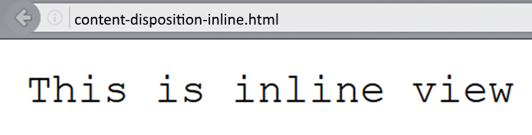
Content-Disposition – Example
Content-Type: text/plain
Content-Length: 19
Content-Disposition: inline filename=example.txt

Slide 41
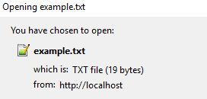
Content-Disposition – Example (3)
Content-Type: text/plain
Content-Length: 19
Content-Disposition: attachment; filename=example.txt

Slide 42

TCP Networking
TCP Handshake, TCP Listener and Sockets

Slide 43


Transmission Control Protocol (TCP)
Standard for establishing and maintaining a network conversation
Provides error-free data transmission
The connection is established using a three-way handshake
SYN
Synchronize packet

Slide 44
Transmission Control Protocol (TCP)
Standard for establishing and maintaining a network conversation
Provides error-free data transmission
The connection is established using a three-way handshake
SYN - ACK
Synchronize
Acknowledgement

Slide 45
Transmission Control Protocol (TCP)
Standard for establishing and maintaining a network conversation
Provides error-free data transmission
The connection is established using a three-way handshake
ACK
Acknowledgement

Slide 46
Transmission Control Protocol (TCP)
Standard for establishing and maintaining a network conversation
Provides error-free data transmission
The connection is established using a three-way handshake
Connection Established

Slide 47
TCP Listener
Provides methods that listen for and accept incoming connection requests
private static async Task ServerListen()
{
int port = 8000;
IPAddress ipAddress = IPAddress.Parse("127.0.0.1");
TcpListener server = new TcpListener(ipAddress, port);
server.Start();
// Establish а connection and read request
}

Slide 48
TCP Client
Connecting, sending, and receiving stream data over a network
var client = await listener.AcceptTcpClientAsync();
Console.WriteLine("Client connected.");
byte[] buffer = new byte[1024];
client.GetStream().Read(buffer, 0, buffer.Length);
byte[] data = Encoding.ASCII.GetBytes("Hello!");
client.GetStream().Write(data, 0, data.Length);
client.GetStream().Dispose();
Connecting with client

Slide 49
TCP Client
Connecting, sending, and receiving stream data over a network
var client = await listener.AcceptTcpClientAsync();
Console.WriteLine("Client connected.");
byte[] buffer = new byte[1024];
client.GetStream().Read(buffer, 0, buffer.Length);
byte[] data = Encoding.ASCII.GetBytes("Hello!");
client.GetStream().Write(data, 0, data.Length);
client.GetStream().Dispose();
Reads data from client's NetworkStream

Slide 50
TCP Client
Connecting, sending, and receiving stream data over a network
var client = await listener.AcceptTcpClientAsync();
Console.WriteLine("Client connected.");
byte[] buffer = new byte[1024];
client.GetStream().Read(buffer, 0, buffer.Length);
byte[] data = Encoding.ASCII.GetBytes("Hello!");
client.GetStream().Write(data, 0, data.Length);
client.GetStream().Dispose();
Writes data to client's NetworkStream

Slide 51
TCP Client
Connecting, sending, and receiving stream data over a network
var client = await listener.AcceptTcpClientAsync();
Console.WriteLine("Client connected.");
byte[] buffer = new byte[1024];
client.GetStream().Read(buffer, 0, buffer.Length);
byte[] data = Encoding.ASCII.GetBytes("Hello!");
client.GetStream().Write(data, 0, data.Length);
client.GetStream().Dispose();
Closes the NetworkStream

Slide 52
Socket
Provides methods and properties for network communication
var socket = await listener.AcceptSocketAsync();
byte[] buffer = new byte[1024];
socket.Receive(buffer);
byte[] data = Encoding.ASCII.GetBytes("Hello!");
socket.Send(data);
socket.Shutdown(SocketShutdown.Both);
Connecting with client

Slide 53
Socket
Provides methods and properties for network communication
var socket = await listener.AcceptSocketAsync();
byte[] buffer = new byte[1024];
socket.Receive(buffer);
byte[] data = Encoding.ASCII.GetBytes("Hello!");
socket.Send(data);
socket.Shutdown(SocketShutdown.Both);
Receive data from client

Slide 54
Socket
Provides methods and properties for network communication
var socket = await listener.AcceptSocketAsync();
byte[] buffer = new byte[1024];
socket.Receive(buffer);
byte[] data = Encoding.ASCII.GetBytes("Hello!");
socket.Send(data);
socket.Shutdown(SocketShutdown.Both);
Send data to client

Slide 55
Socket
Provides methods and properties for network communication
var socket = await listener.AcceptSocketAsync();
byte[] buffer = new byte[1024];
socket.Receive(buffer);
byte[] data = Encoding.ASCII.GetBytes("Hello!");
socket.Send(data);
socket.Shutdown(SocketShutdown.Both);
Close connection

Slide 56
Socket
Provides methods and properties for network communication
var socket = await listener.AcceptSocketAsync();
byte[] buffer = new byte[1024];
socket.Receive(buffer);
byte[] data = Encoding.ASCII.GetBytes("Hello!");
socket.Send(data);
socket.Shutdown(SocketShutdown.Both);
Options to disable send/receive

Slide 57
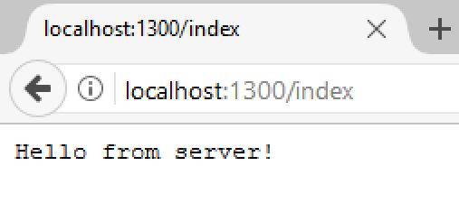
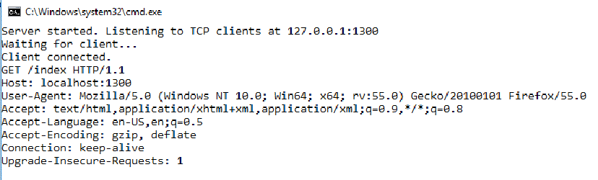
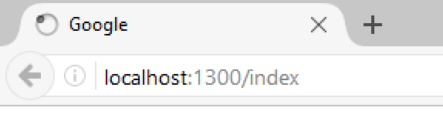
Problem: Simple Web Server
Write a simple web server
Receive a request from a client
Print the request on the console
Write response to client's interface

Slide 58
Solution: Web Server with TcpClient
public async void Connect(TcpListener listener)
{
while (true)
{
// TODO: Accept TcpClient
// TODO: Read request data
// TODO: Send data to client
var message = Encoding.ASCII.GetString(buffer);
Console.WriteLine(message);
client.GetStream().Dispose();
}
}

Slide 59
Solution: Web Server with TcpClient
static void Main()
{
IPAddress address = IPAddress.Parse("127.0.0.1");
int port = 1300;
TcpListener listener = new TcpListener(address, port);
listener.Start();
var task = Task.Run(() => Connect(listener));
task.Wait();
}

Slide 60
Solution: Web Server with Socket
public async void Connect(TcpListener listener)
{
while (true)
{
// TODO: Accept socket
// TODO: Read request data
// TODO: Send data to client
var message = Encoding.ASCII.GetString(buffer);
Console.WriteLine(message);
socket.ShutDown();
}
}

Slide 61

Summary
…
…
…
HTML forms can send 2 types of HTTP requests: GET and POST
HTTP works with message pairs called HTTP request and HTTP response
HTTP headers describe the request / response metadata
See the most used headers here
The URL parts define:
protocol, host, port, path, query string, and fragment

Slide 62
https://softuni.bg/trainings/courses

Slide 63












SoftUni Diamond Partners

Slide 64




Trainings @ Software University (SoftUni)
Software University – High-Quality Education and Employment Opportunities
softuni.bg
Software University Foundation
http://softuni.foundation/
Software University @ Facebook
facebook.com/SoftwareUniversity
Software University Forums
forum.softuni.bg

Slide 65

License
This course (slides, examples, demos, videos, homework, etc.) is licensed under the "Creative Commons Attribution-NonCommercial-ShareAlike 4.0 International" license

